Slide 1
BANK
MANAGEMENT

Slide 2
Chapter 1
An Introduction
to the Business of Banking

Slide 3
1.1 The Emergence and Development of Modern Banking
1.2 The Role of Banks
1.3 Trends Affecting All Banks
1.4 The Change in Bank’s existence environment

Slide 4
1.1 The Emergence and Development of Modern Banking
……

Slide 5
1.2 The Role of Banks
The many different roles banks play in the economy
The functional roles of banks
The role of banks in theory
The services banks offer the public

Slide 6
The intermediation role
The payments role
The guarantor role
The agency role
The policy role
The risk management role
The saving/investment advisor role
The safekeeping/certification of value role
AI G PP RAC

Slide 7
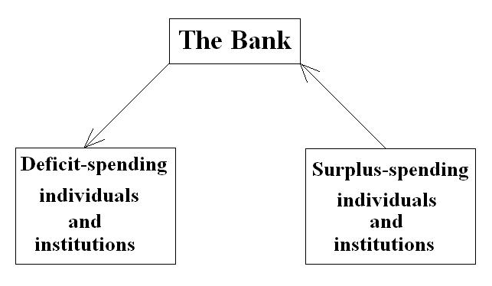
The Role of Banks in Theory
Banks are financial intermediaries selling financial services. The term financial intermediary simply means a business that interacts with two types of individuals and institutions in the economy.

Slide 8
The Role of Banks in Theory
Banks’ intermediation activities will take place :
- if there is a positive spread between the expected yields on the loans banks make to deficit-spending units and the expected interest rate (cost) on the funds banks borrow from surplus-spending units;
- if there is a positive correlation between the yields on bank loans and the interest rates banks pay for deposits and other funds provided by surplus-spending units.

Slide 9
The Role of Banks in Theory
After we have found that the financial systems and financial markets in the developed countries are extremely efficient, we wonder why commercial banks still have survived and developed under such circumstances.
这里extremely efficient 就不是完全竞争市场了

Slide 10
The Role of Banks in Theory
The reasons for banks’ existence in theory are :
- Imperfections in the financial market system.
因为有门槛：50万才能进入股指期货，但是现在门槛变低了吗？总会存在的。Think about what?
- Banks’ willingness to accept risky loans from borrowers, while issuing low-risk securities to their depositors.
因为average default probability会下降很多（大数定律，E会趋于常值）
- Banks’ ability to satisfy the strong need of many customers for liquidity.
如果很多借款人想借钱，我不能承受，但银行可以
- Banks’ superior ability to evaluate information.
有很多学统计的、数学的、金融的在工作
- Banks’ delegated(授权的) monitoring function.
如果你买了华为的股票，我不能看财报。但银行需要，并且可以看它们的财报

Slide 11
Services Banks Offer the Public
Traditional items:
Carrying out currency exchanges
正在古Greece就有这个业务
Discounting commercial notes and making business loans
贴现
Offering savings deposits（储蓄存款）
depositors are individuals,储蓄窗口、对公窗口在银行里
Safekeeping of valuables and Certification of value
成龙的《我是谁》,become mortage
Supporting Government activities with credit
政府在打仗，银行借给他们钱
Offering checking accounts (demand deposits)
Offering trust services
《Rainman》is about trust service
Notes:
dasdasdas

Slide 12
Services Banks Offer the Public
Services banks have developed more recently:
-Granting consumer loans
Theory of Life cycle,20岁缺钱，39岁还钱
Financial Advising
Managing Cash
Temporary cash income
Offering equipment leasing
有点像make loan
Making venture capital loans
Selling insurance services
两方面？？
- Selling retirement plans
在老年化时代,try some extra retirement plans
- Offering security brokerage and security underwriting services
Offering mutual funds and annuities
银行和公司合作出年金
Offering investment banking and merchant banking services

Slide 13
Convenience: The Sum of All Bank Services
It should be clear from the list of services we have described that not only are most banks offering a wide array of financial services today, but the banker’s service menu is growing rapidly. New types of loans and deposits are being launched every year. Viewed as a whole, the impressive array of services offered by modern banks adds up to greater convenience for their customers. Customers can satisfy virtually all their financial service needs at one financial institution in one location. Banks are the “financial department stores” of modern era, working to unify banking, fiduciary, insurance, and security brokerage services under one roof – a trend often referred to as universal banking in the world.

Slide 14
1.3 Trends Affecting All Banks
Service Proliferation
Rising competition
许多financial institution进入,还有deregulation, 如liberalation of interest rate,decide their own loan and deposit rate。还有exchange rate,从fixed rate到managed flow再到free float??李克强说open our finance industry to foreign investors
Deregulation
Rising funding costs
0.3%是我们的基准利率。而alipay是4.1%，
An increasingly interest-sensitive mix of funds
我们很利率敏感啊
A technological revolution
因为比尔盖茨认为科技革命，所以他说银行正在消亡，next time orally answer me!
Consolidation and geographic expansion (A tier institutional system)
Multinational banks是大大的商业银行。
National banks可以在全美国做业务，和美联储谈判
Regional banks
City banks，像成都银行（刚刚上市）
Community banks
Convergence
Globalization of banking
Increased risk of failure and the weakening of government deposit insurance systems
中国的government deposit insurance system才建三年，只有5000以下才被cover

Slide 15
1.4 The Change in Bank’s existence environment
- The competing financial institutions against banks
The Financial Services Modernization Act of 1999 in the US (P47) it’s the very important change,它抹去了invest和commer的区别，而1933年的Act建立了
Dodd-Frank Wall Street Reform and Consumer Protection Act of 2010作业！！查阅问答，和2008年金融危机有关，what’s the compaign?
The convergence of financial services among banks and its competitors
The internationalization of financial supervision - Basel Accord II & III在第三章详细讲述

Slide 16
Savings and loan associations 储蓄贷款协会，belongs to corporative financing,信贷联
Credit unions
Money market funds
Mutual funds
Hedge funds 亚洲金融危机，索罗斯的反射理论，financial alchemy金融炼金术
Security brokers and dealers
Finance companies大众依赖于他们而不是bank
Financial holding companies or conglomerates
金融控股公司financial holding company, 金融集团conglomerate
Life and property/casualty insurance companies

Slide 17
2014-2016
Top 25 Banks in the World
给一个月做，分析变化
1.From capital Tier one Capital 一级资本
2.Total Assets
3.Profits any data(before tax or after tax)
Thebanker.com
From data what can you know, what conclusion
Draw figure? Make forms? Make 9 forms at least
Maybe the situations changes of chanese banks? American banks, Japanese banks? Maybe I focus on profits, maybe they get less and I found a reason for that.最好不要从网上抄结论

Slide 18
Top 25 by total ass
“Banks Are Dying!”
???
Changing to a new form
Their basic business does not change but the way of business has changed
They have a lot of operations and functions which makes them stronger.

